Slide 1
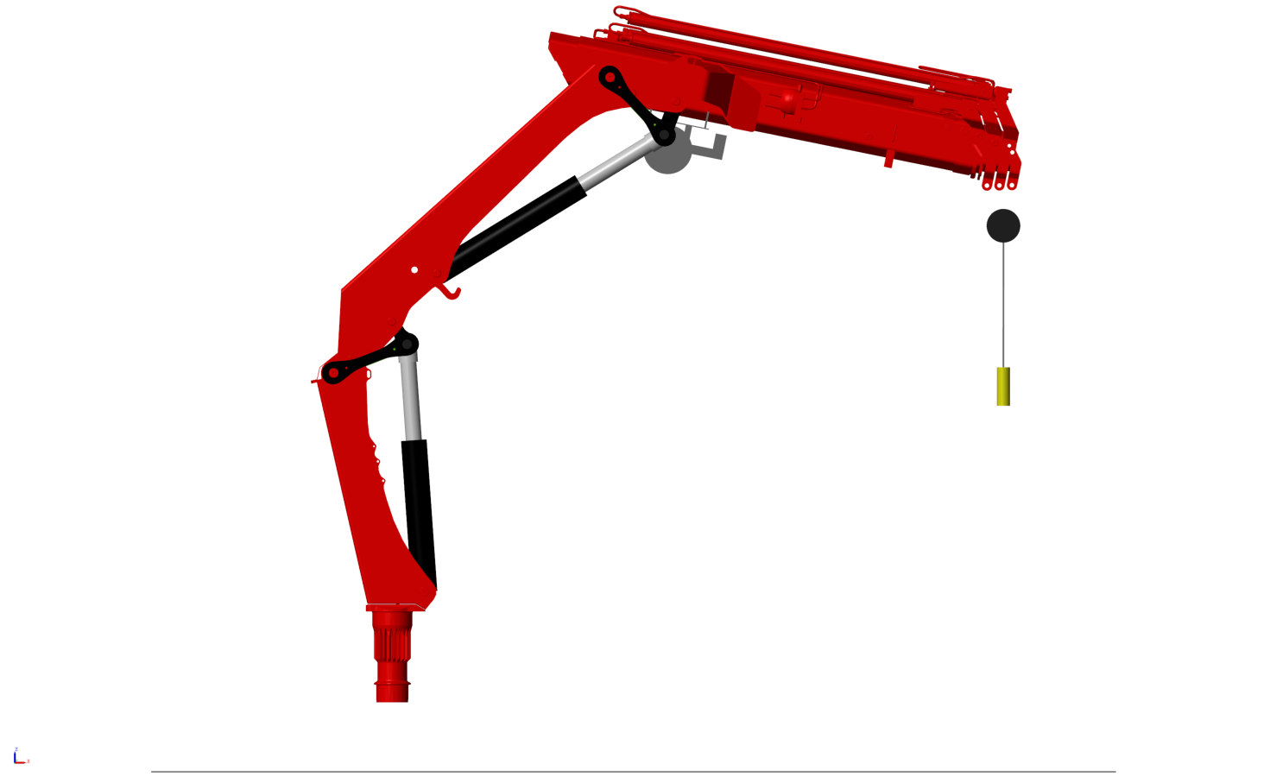
4
5
3
Column
Main cylinder
Jib cylinder
Main arm
Jib arm
1
2

Slide 2
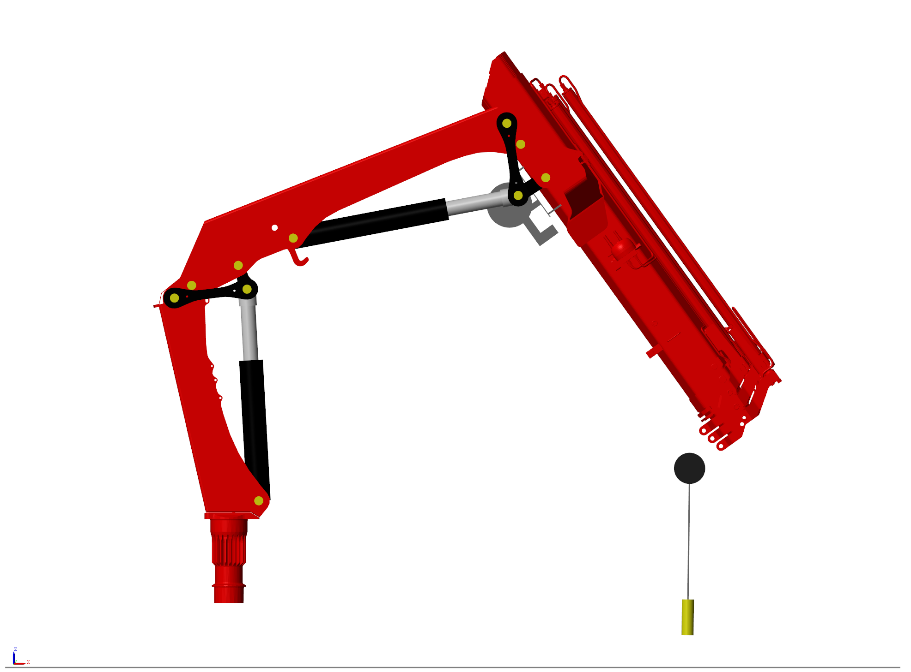
G
C
K
F
I
B
H
D
E
J
A

Slide 3
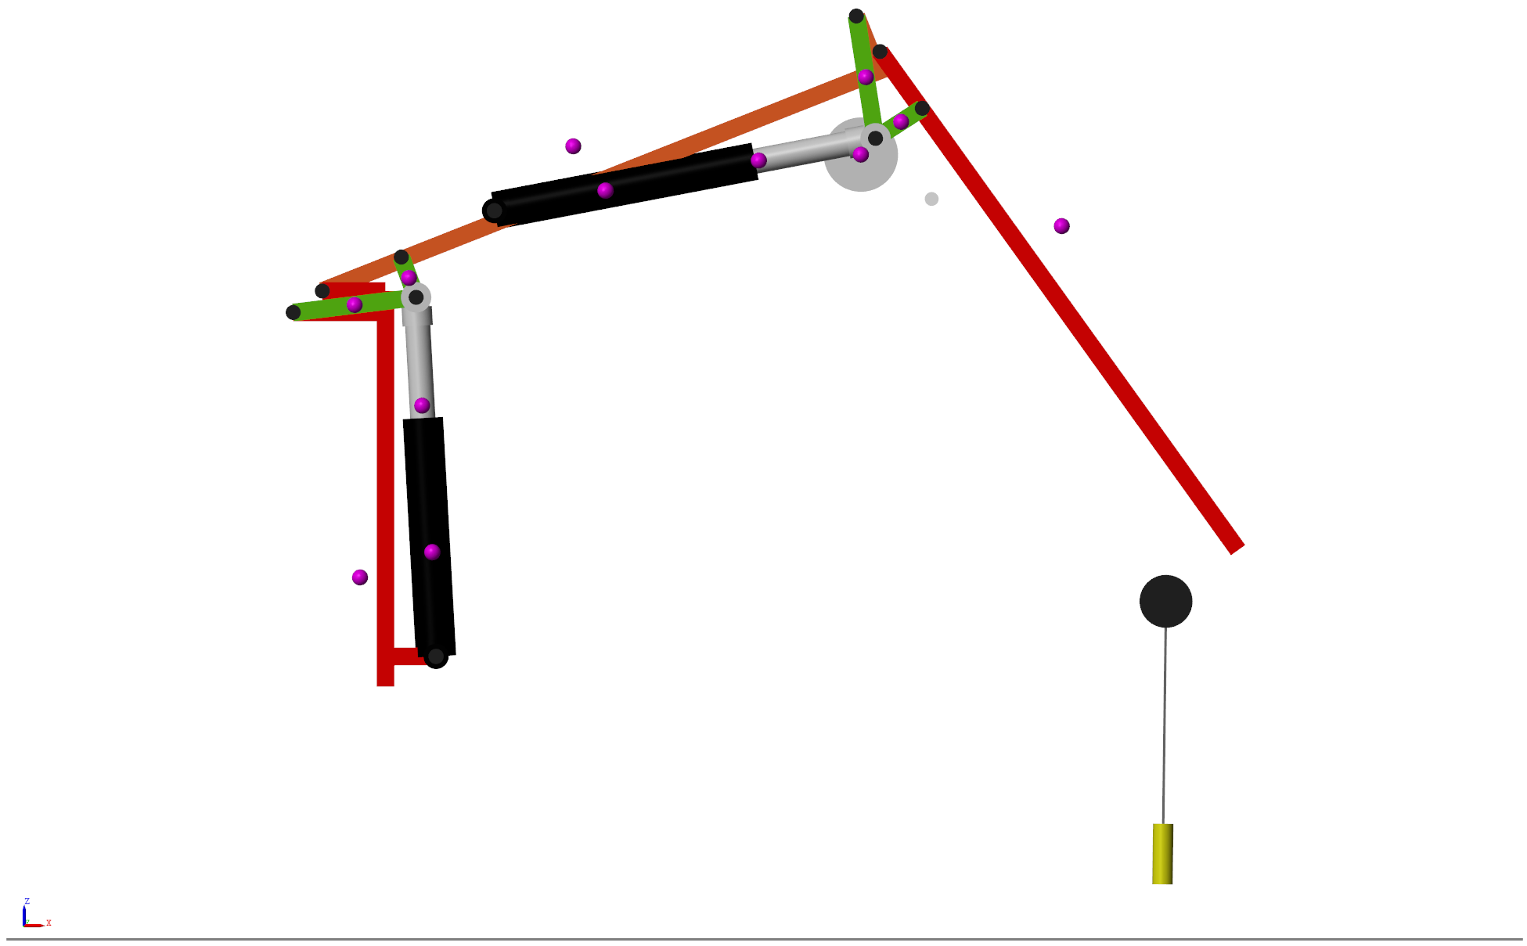
G
C
K
I
F
B
H
D
E
J
A

Slide 4
G
C
K
I
F
B
H
D
E
J
A

Slide 5
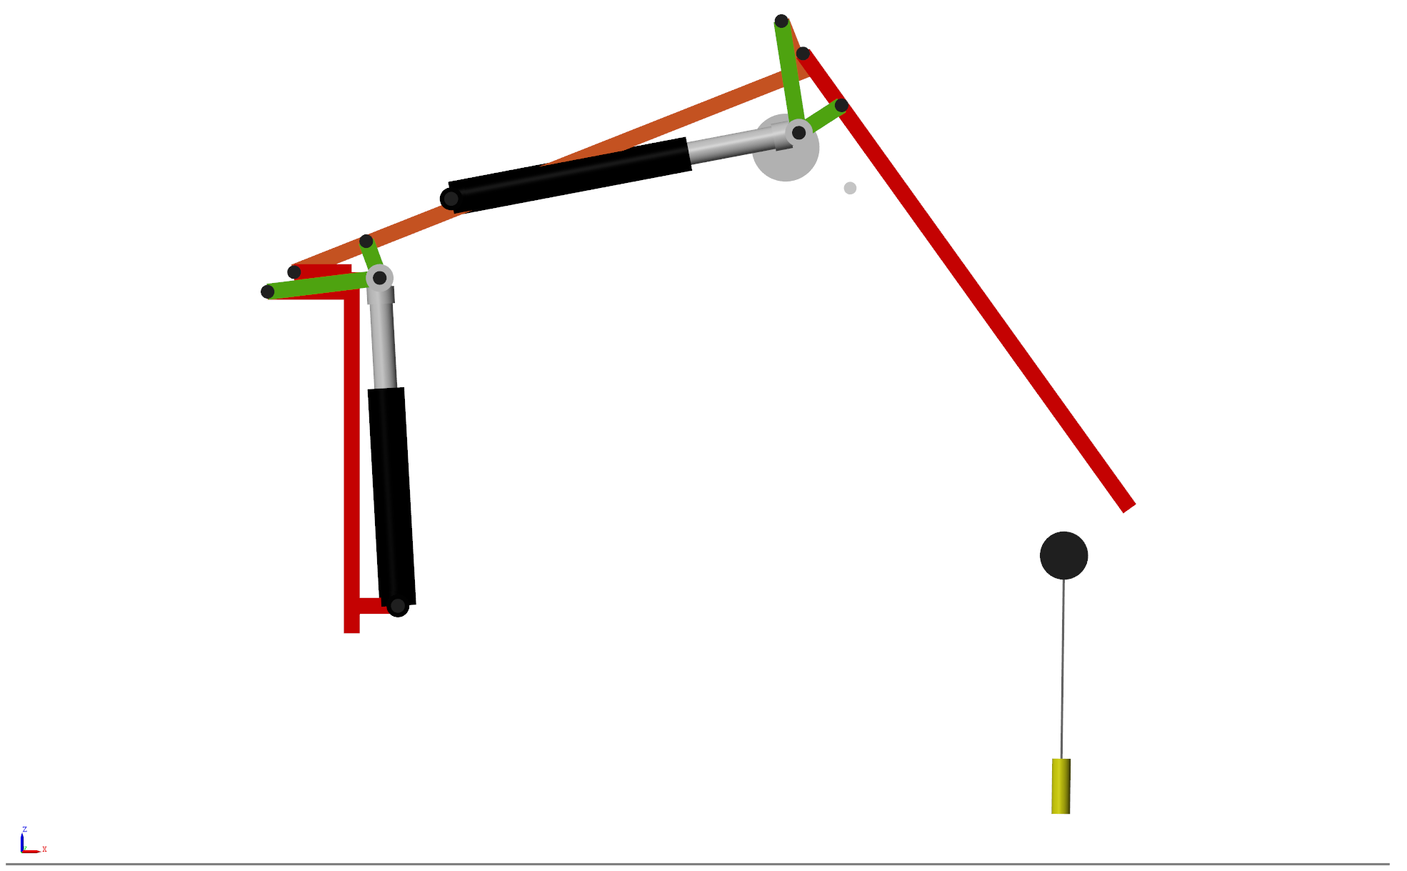
G
C
K
I
F
B
H
D
E
J
A

